Slide 1
Final Project
BANA 6610

Slide 2
Project Description
Kaggle Competition to predict the final Sale Price of each home
Utilizes the famous Ames Housing data set with 79 explanatory variables describing (almost) every aspect of residential homes in Ames, Iowa.
Submissions are evaluated on Root-Mean-Squared-Error (RMSE) between the logarithm of the predicted value and the logarithm of the observed sales price. (Taking logs means that errors in predicting expensive houses and cheap houses will affect the result equally.)
Most top submissions have a RMSE of 0.1 – 0.11 and I am shooting for < 0.15

Slide 3
Major Findings
86.28% of the variation in home Sale Price in Ames, Iowa is explained by the variation in the overall material and finish quality, above ground living area square feet, size of garage in car capacity, total square feet of basement area, first floor square feet, year built, remodel date, number of fireplaces, wood deck area in square feet, lot size in square feet, number of basement full bathrooms, unfinished square feet of basement area, number of kitchens, screen porch area in square feet, building class and pool area in square feet, taking into account the sample size and number of independent variables

Slide 4
Recommendations for Action
Given my findings, my recommendation is to try more advanced feature engineering (pertaining to categorical variables), attempt a random forest approach, and potentially even use gradient boosting with machine learning to improve predicted values. The predicted values start to vary widely with Sale Prices at the tip and tail of the Sale Price distribution.

Slide 5
Analytical Overview
A quick normality summary of the data set using the psych package
Log transformation on right-skewed variables and added to data set
Identified variables with a large amount of nulls (PoolQC, MiscFeature, Alley, Fence, FireplaceQu)
Created a correlation matrix to find correlation to SalesPrice, but also identify any potential collinearity that may arise.
Best subsetting (leaps package) and stepwise techniques were utilized in conjunction with correlation for variable selection.
An iterative process (model fitting, model diagnosis and cross-validation) was utilized to locate the highest adjusted R squared, while trying to minimize RMSE.
Ultimately, a model was created that allowed for an explanation of 86.28% of the variation.

Slide 6
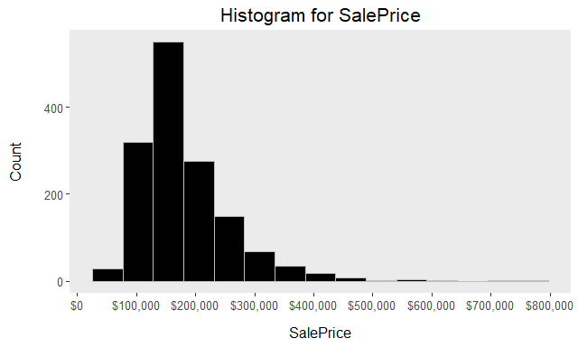
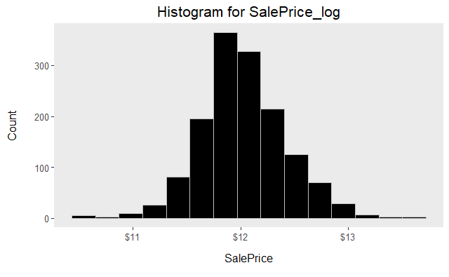
Analytical Overview – Normalizing SalePrice
SalePrice is heavily right-skewed, but with a log transformation SalePrice approaches normal

Slide 7
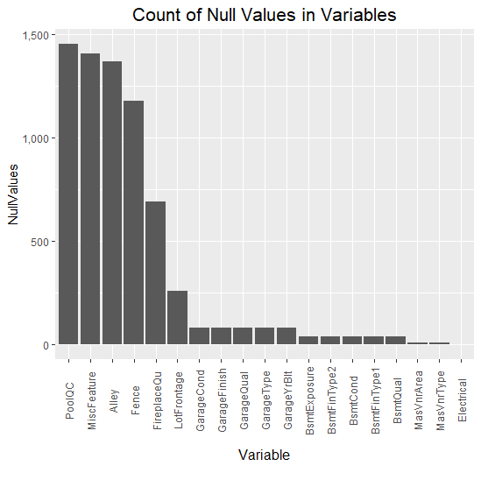
Analytical Overview – Null Values
There are quite a few variables with over 1,000 null values and other variables with quite a significant amount of missing data points as well. Ultimately, we can just eliminate these variables from the data set. They will not add value.

Slide 8
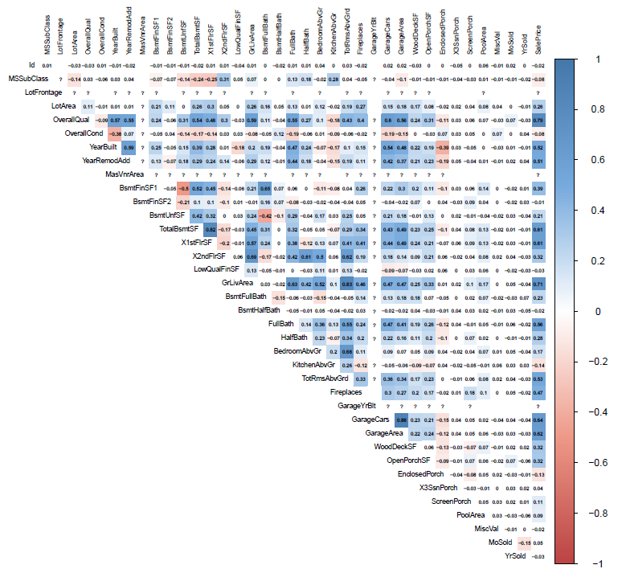
Analytical Overview – Correlation Matrix
There are quite a few variables that are highly correlated with each other and we need to be mindful of this when utilizing subsetting and stepwise. These methods could lend themselves to collinearity.

Slide 9
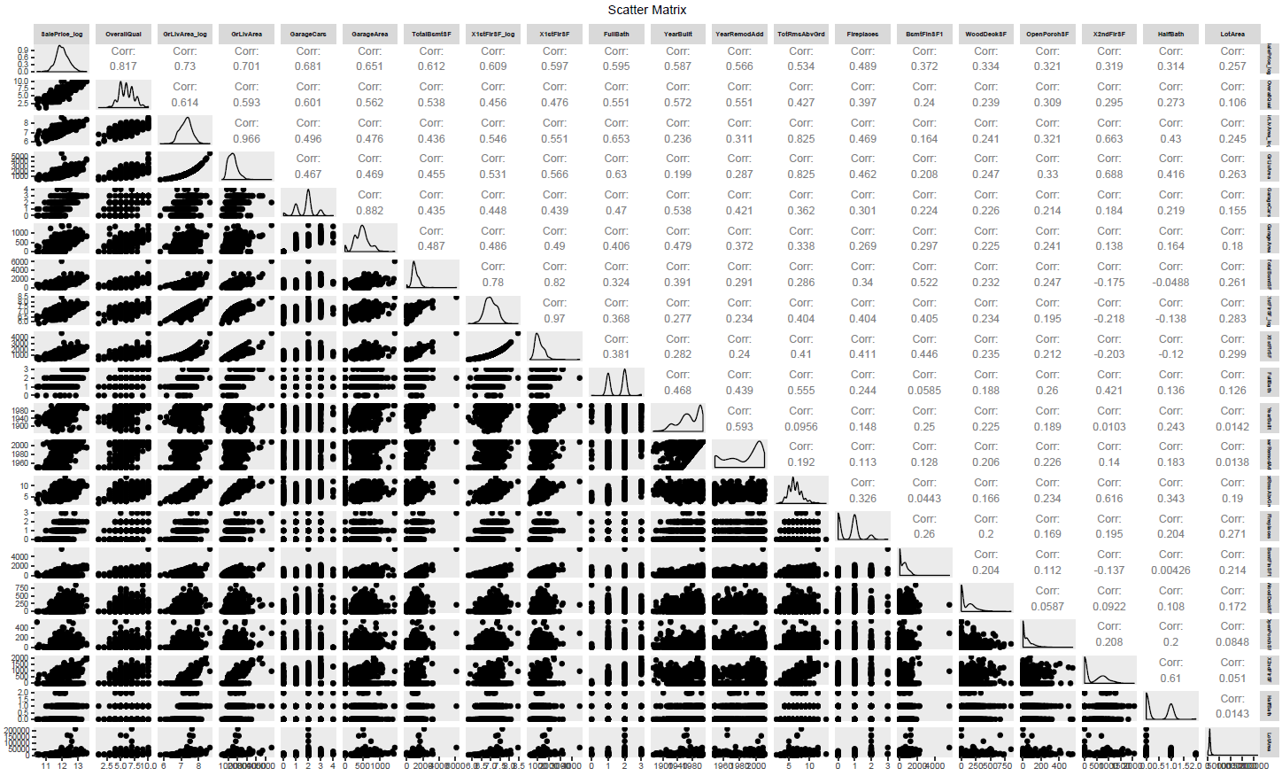
Analytical Overview – Scatter Matrix

Slide 10
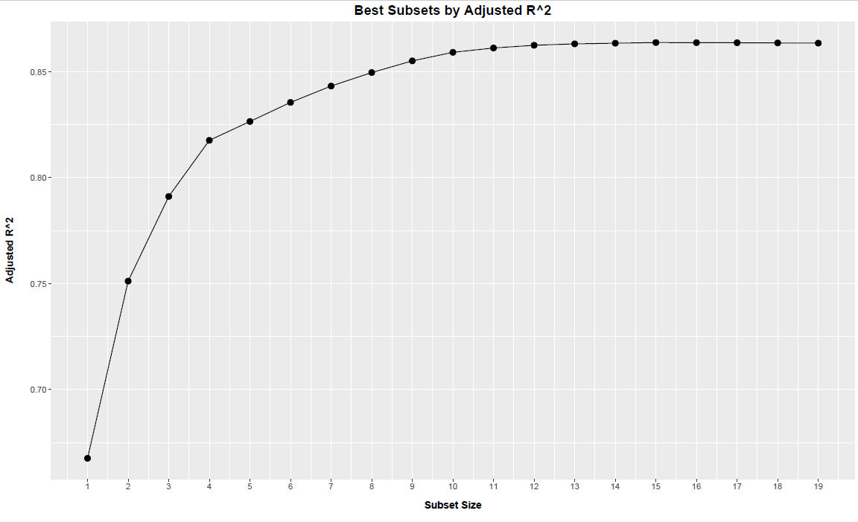
Analytical Overview – Best Subsets
The adjusted correlation coefficient seems to top out around 0.87. There doesn’t appear to be too much lift from the next additional variable at a subset size of 12.

Slide 11
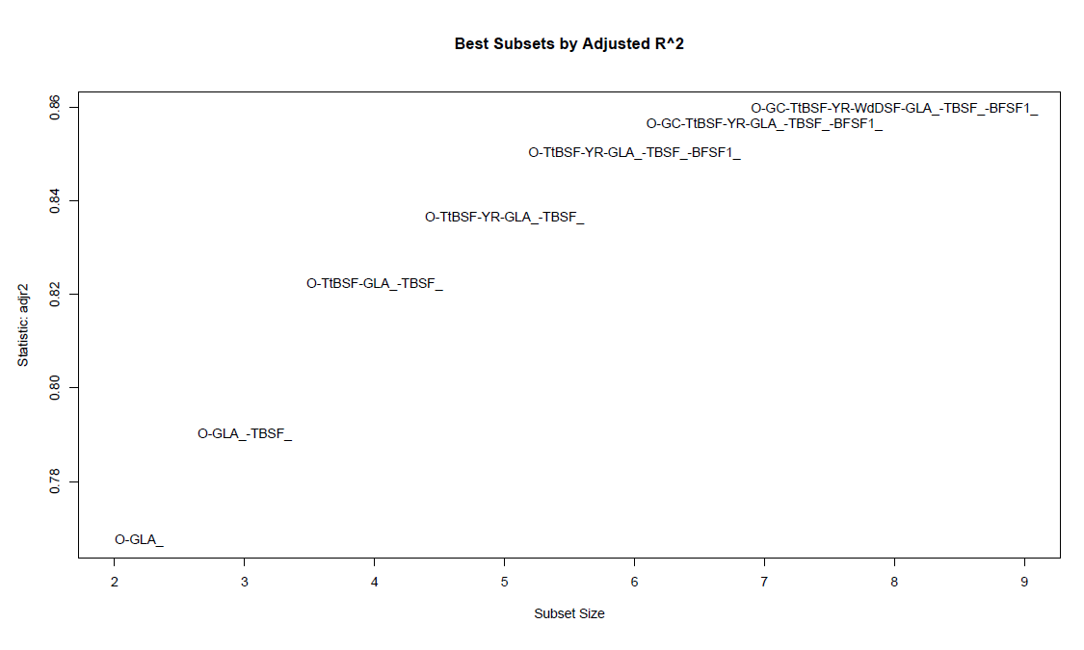
Analytical Overview – Best Subsets with Variables

Slide 12
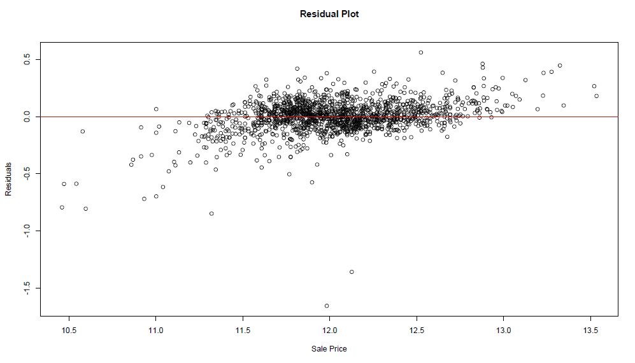
Model Validation – Residuals Scatter
This appears to be random with no patterns.

Slide 13
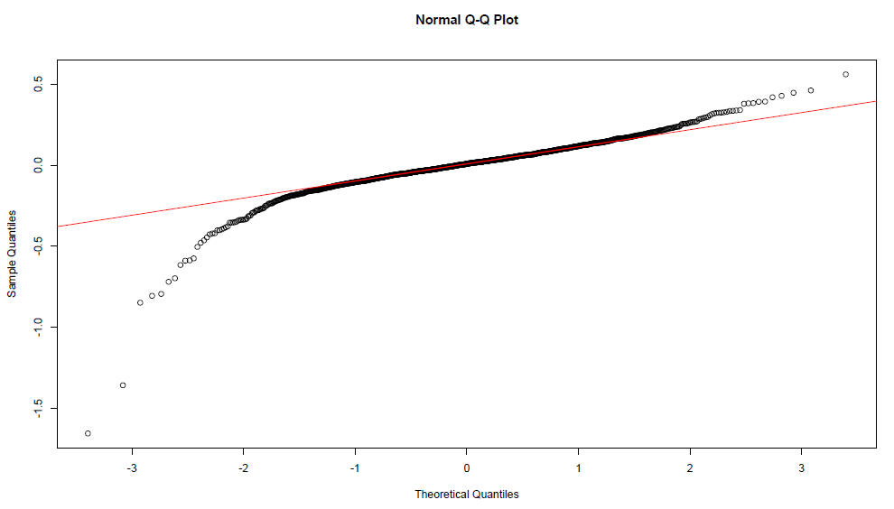
Model Validation – Residuals Normal Probability Plot
The line is virtually straight through the center, with variation at the tip and tail. This approaches normal and passes our validation test. The variations are likely caused by extremes in housing prices that haven’t been accounted for in the data as of yet.

Slide 14
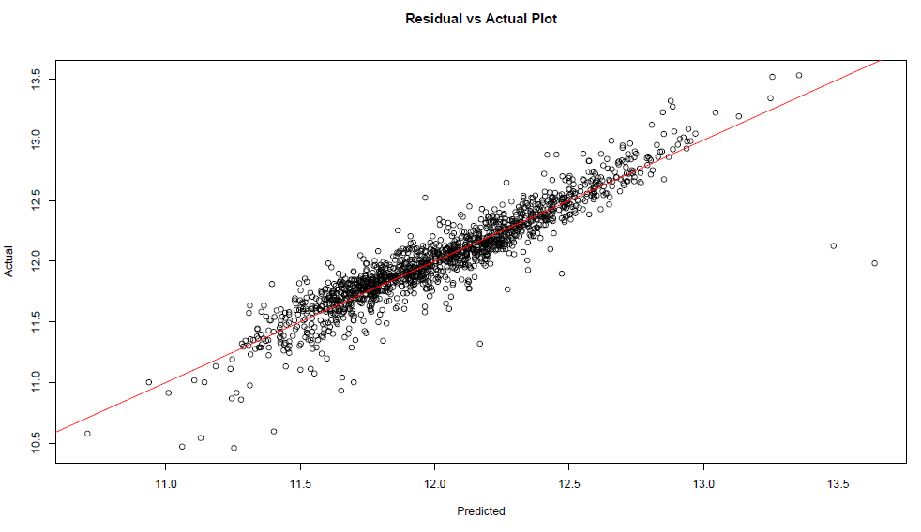
Model Validation – Residuals vs Actuals
(pats self on back)

Slide 15
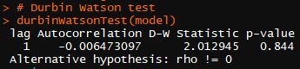
Model Validation – DW and VIF
The Durbin Watson test shows that there is no homoscedasticity The VIF reveals that there is no collinearity, but TotalBsmtSF and 1stFlrSF could be relatively similar and should ultimately be looked into.

